Slide 1
Welcome
TEAMWORK
“Together We Can Achieve the Extraordinary”
SPRING INVESTOR SALONS
April 2018
Notes:
Leave up as people enter –so they know they are in the right place ;)
Get everyone to sign in!!!
get contact info!

Slide 2
What Is Going On With My Investment?
DCI EDUCATION COMMITTEE
SPRING INVESTOR SALONS 2018
Notes:
WE HAVE A LOT TO COVER IN JUST 1 HOUR
BRIEF review of last workshop –not time t go over it all
Discuss options related to the 2018 Purchase decision, including who it affects and how it might work. Present the relevant information that must be considered in order to make the decision. Explain the current status of preparing for the decision.

Slide 3
Introduction
Narri Cooper
DCI AC Education Committee
Investor Engagement Coordinator
Notes:
2018 decision is a big deal, but before we can discuss that we need to understand what the Charter provision says and hOw it affects our investment

Slide 4
WHAT ARE WE HERE TO DISCUSS?
Investment Overview
Mall Profitability Review
Purchase Provision Review
Purchase Options Update
Liquidity Issues
Legacy Challenge
Key Questions to Consider
Next Steps
Notes:
We want to bring you up to speed

Slide 5
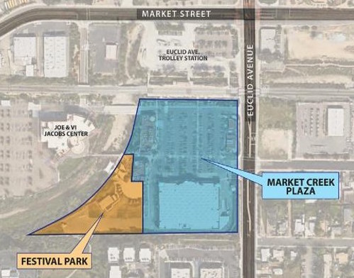
WHAT DO WE OWN?
Notes:
Discuss Leasing issue? Charter school contract will be presented in November
Our investment covers a very specific area –the the Purchase pertains to our ownership of the mall
CURRENTLY WE OWN approximately 20% OF MCP & FESTIVAL PARK (NOT THE AMPHITHEATRE)
That % could increase as part of the 2018 PROVISION (to almost 50% with NUF)

Slide 6
WHO OWNS WHAT?
MARKET CREEK PARTNERS OWNS THE MALL
DCI
NUF
JCNI
DMI
Where does CIF fit in?
A Subset of Investors that reinvested distribution checks to form a separate investor group
Notes:
Understand how we all relate
CIF is not a partner!!!! It is a separate investment group
They invest tier money outside the mall

Slide 7
HOW MUCH DO WE OWN?
MEMBER’S EQUITY AS OF 12/31/16
Diamond Community Investors $ 350,506
Neighborhood Unity Foundation ____ $ 378,761
DMI $ 107,530
JCNI $ 3,920,809
OWNERSHIP PERCENTAGE AS OF 12/31/16
Diamond Community Investors 18.02 %
Neighborhood Unity Foundation 20.00 %
DMI 4.93 %
JCNI 57.05 %
Notes:
See below and side page if more questions
This reflects our current ownership status
What caused the DMI % of ownership to change from 4% to 4.93%?
In the past, DMI purchased units back from DCI investors that passed away.
PRIOR;
JCNI 60%
DCI 20%
NUF 20%
Per Kurt
DMI started off with a small percentage in “DMI Units.” JCNI started off with about 60% in “JCNI Units.” Over the years, some of the DCI Units were sold to DMI by DCI Unit holders.
Why has the DCI total ownership reduced from ($500,000) in 2007 to ($350,500) in 2017? Units sold back to JCNI would not account for that large a drop in value nor would the $9.78 current unit price. We no longer own 20% as we assumed.
DCI equity ownership has reduced over the years primarily due to MCP’s net losses each year. Each year MCP incurs a negative net income the total equity in MCP decreases. Since each member has an interest in the equity of MCP their individual equity balance also decreases based on the number of units owned in years with net losses.
Equity is a calculation , not a cash balance, it is affected every time our financials show a loss

Slide 8
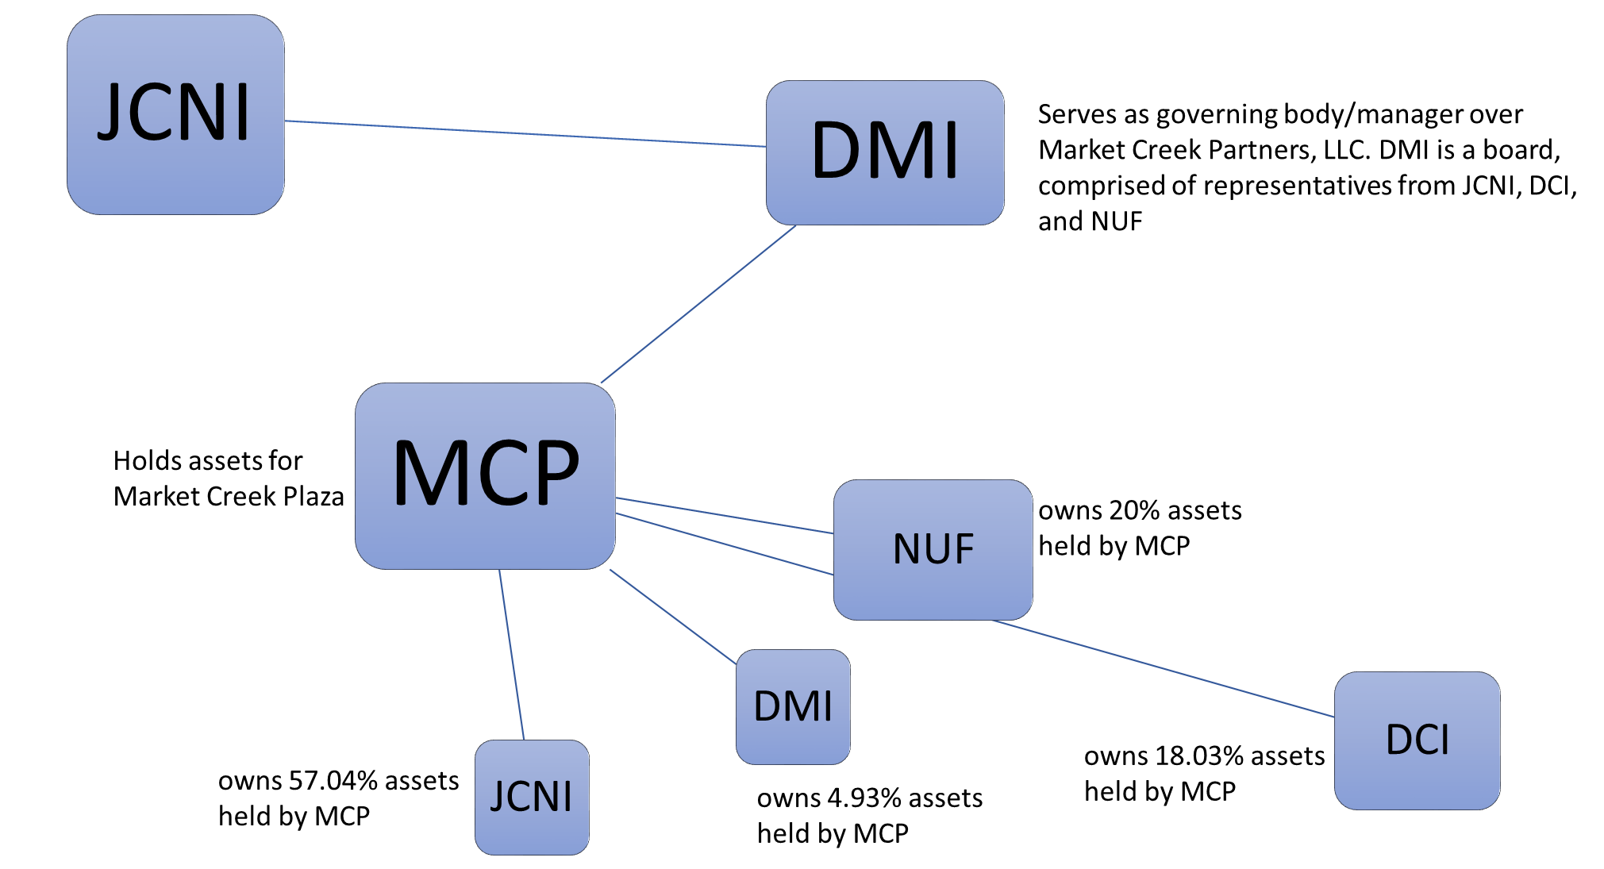
ORG CHART

Slide 9
HOW IS THE MALL DOING? MALL DASHBOARD 1/2018
Notes:
Get latest!!!!

Slide 10
WHAT HAPPENED TO OUR CHECKS?
Waterfall Reminder
Distribution vs Dividends
Income vs Value
Profitability Factor
Income-Expenses=PROFIT
Income –Rents, CAMs
Expenses –Operating Expenses, Depreciation, General & Administrative Expenses
Leveraging –too much debt affects profitability
Overbuilt Assets affect profitability

Slide 11
PROFITABILITY PROJECTIONS

Slide 12
2018 PURCHASE REVIEW
The charter includes provisions that allow for the JCNI units to be Purchased (“bought out”) in order to increase the ownership percentage of DCI & NUF
Our partners –JCNI & NUF must agree to any transaction we, DCI, might propose
There are specific timelines and requirements that must be met
Notes:
Section 6 of the Charter Agreement (investors received with the prospectus and a revised version in 2012) defines the Purchase transaction. This workshop is from DCI perspective primarily, although NUF & JCNI are affected and will be referenced as needed, the focus today is on our investor perspective and educating them.
NO PROVISION TO BUYOUT NUF!!!
HOWEVER SOME SCEMARIOS
Add a slide that outlines all possible transactions under the 2018 Purchase Transaction
a) The Company (DCI) borrows additional funds to buy-out JCNI.
b) A third-party investor (which could be a for-profit or non-profit organization) purchases an interest in MCP and that investment is used to buy out JCNI.
c) Another company merges with MCP and in the process, buys out JCNI.
d) Any of the preceding three alternatives are adopted, and in the process, in addition to JCNI being bought out, some or all of NUF and/or the DCI Investors are bought out.

Slide 13
REVISIT DECISION REVIEW
2018 is not our only chance to Purchase!
Investors will have a chance to reconsider the Purchase option every 3 years (as long as there is a company)
The Council can submit a new recommendation in 2021
Then there would be another opportunity in 2024
Per the Operating Agreement section 1.4, the Company will dissolve in 2025
Notes:
Per Kurt
As stated in slide 28, 2021 would be the next opportunity to repurchase, and then there would be an opportunity in 2024. Under Section 1.4 of the Operating Agreement, the company will dissolve in 2025.

Slide 14
FACTORS TO KEEP IN MIND
The Charter Provision;
Was not designed to simply replace JCNI with a new majority partner
Was intended to provide a mechanism to increase mall ownership by the community
Was intended to establish a long-term asset for the community benefit

Slide 15
POTENTIAL SCENARIOS
The Company (MCP) borrows additional funds to buy-out JCNI.
A third-party investor (which could be a for-profit or non-profit organization) purchases an interest in MCP and that investment is used to buy out JCNI.
Another company, REIT or non profit merges with/replaces MCP and in the process, buys out JCNI.
Any of the preceding three alternatives are adopted, and in the process, in addition to JCNI being bought out, some or all of NUF and/or the DCI Investors are bought out.
Notes:
NO PROVISION TO BUYOUT NUF!!!
HOWEVER SOME SCEMARIOS
Add a slide that outlines all possible transactions under the 2018 Purchase Transaction
a) The Company (DCI) borrows additional funds to buy-out JCNI.
b) A third-party investor (which could be a for-profit or non-profit organization) purchases an interest in MCP and that investment is used to buy out JCNI.
c) Another company merges with MCP and in the process, buys out JCNI.
d) Any of the preceding three alternatives are adopted, and in the process, in addition to JCNI being bought out, some or all of NUF and/or the DCI Investors are bought out.

Slide 16
STATUS UPDATE
ESTABLISHED CONFIDENTIALITY PROTOCOLS
DEFINED PROCESS & PROJECT PLAN
DCIAC SUBMITTED PROJECT BUDGET TO JCNI
BUDGET APPROVED
TIMELINE & PROJECT PLAN COMPLETED
SECURED LEGAL COUNSEL
TASKFORCE RESEARCHING POTENTIAL SCENARIOS
FINANCING/INVESTORS
PARTNERSHIPS/FOUNDATIONS
PROFIT/NONPROFIT
LIQUIDITY

Slide 17
KEY DATES TIMELINE
APRIL 2017 -2018 TASKFORCE ESTABLISHED
JULY 2017 –INVESTOR WORKSHOPS
SEPTEMBER 2017 –INVESTOR WORKSHOPS
SPRING 2018 –INVESTOR SALONS*
JULY 2018 - APPRAISAL DUE*
SEPTEMBER 2018 – RECCOMENDATION/VOTE DUE*
Notes:
THINGS CAN HAPPEN EARLIER BUT NOT LATER
*AS NEEDED DEPENDING ON RECCOMENDATION STATUS

Slide 18
Buying & Selling of Units
JCNI is restricted by the SEC from conducting an internal market
JCNI/DMI is permitted to repurchase units from deceased investors and their beneficiaries ONLY
Per section 9 in the MCP Operating Agreement and sections 1.4.5 & 1.4.6 and 3 of the DCI Charter;
Current investors may purchase units from other investors
Current investors may sell units to Qualified Buyers*
DCI members should contact DCIAC for information about purchasing or selling units and to review the process
619-450-4070 or dci@jacobscenter.org

Slide 19
LEGACY CHALLENGE CAMPAIGN
Sell 10 units to the next generation
Your Son or Daughter
Your Niece or Nephew
Your Grandchild
Start our Future Now!
Focus on 18-35 year olds
Keep It in The Family
They have to Live, Work, Serve Here
Notes:
Do it in the next 3 months to participate in 2018 discussions and decisions

Slide 20
QUESTIONS?
Notes:
Also ask for any other ideas
WHAT ELSE CAN WE DO TO PREPARE FOR THIS RECOMMENDATION/DECISION?
HOW CAN WE HELP ENGAGE/PREPARE INVESTORS?
WHAT CAN WE DO AS INVESTORS TO BE MALL ADVOCATES AND PROMOTERS?
ANYONE INTERESTED IN BEING MORE INVOLVED? –COUNCIL, ED COMMITTEE, ETC

Slide 21
SUGGESTIONS
Notes:
WHAT CAN WE DO BETTER? WHAT HAVE WE MISSED? HOW CAN WE GET INVESTORS ENGAGED?

Slide 22
TELL A FRIEND!
Remind other Investors- Today’s Topic Repeats
Thursday 4/26@6pm
Saturday 4/28@ 9am
Notes:
10 year reminder?
Discuss current status of the research, process and options so far related to the 2018 decision, including who it affects and how it might work. Present the relevant information that must be considered in order to make the decision. Explain the current status of preparing for the decision
Other Topics to be offered throughout the year
Proposal
Thursday & Saturday Workshops –Jan/Feb 2018 if needed for 2018
Mailing with explanation/presentation- Feb 2018

Slide 23
Thank You
TEAMWORK
“Together We Can Achieve the Extraordinary”
2018 SPRING SALON SERIES
Notes:
Project as they leave
Make sure late arrivals signed in –get contact info!

